Slide 1
INTELLIGENT INFORMATION ACCESS AND NATURAL LANGUAGE PROCESSING
Emotional City
Professors:
Giovanni SEMERARO
Pierluigi CASSOTTI
Student:
Davide DI PIERRO

Slide 2




WHAT IS EMOTIONAL CITY
Emotional City is an integrated platform that, through public sources (newspapers, social platforms, opendata, etc.) carries out an NLP pipeline that involves sentiment analysis process and lexical semantic change detection.

Slide 3
PIPELINE
01
02
03
DATA EXTRACTION
API IMPLEMENTATION
RETRIEVE DATA
Extraction of tweets from Twitter
Python application for looking for data
Emotional City for retrieving data

Slide 4
DATA EXTRACTION

Slide 5
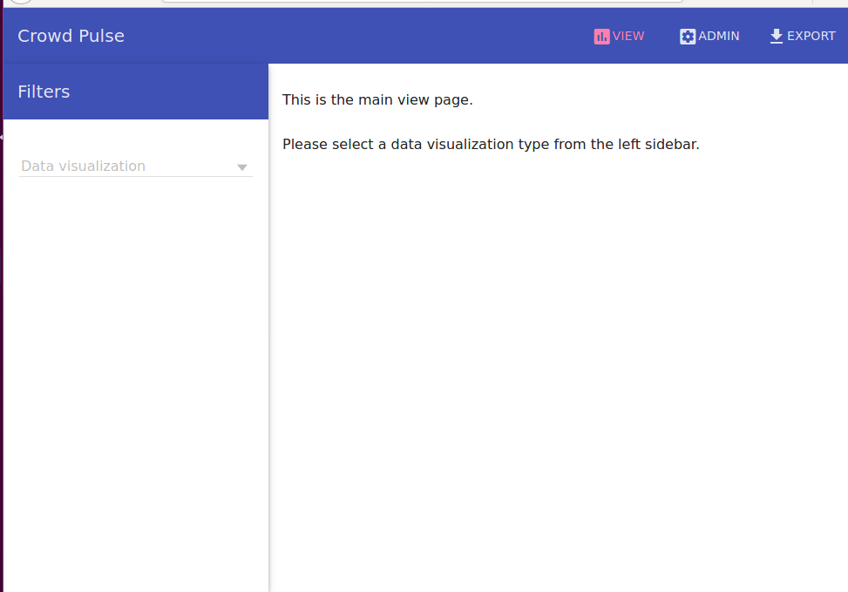
CROWD PULSE
For data extraction, I used Crowd Pulse. It is a platform which provides a graphic interface to visualize data extracted from Twitter. The extraction can be done writing a configuration file in JSON.
I decided to use Crowd Pulse because of its easiness of use and the large number of operations it provides. These operations or extensions are called plugins.

Slide 6
AVAILABLE PLUGINS
email-notify social-twitter
social-facebook data-java
detect-language-optimaize geo-profile-google-maps
geo-message-from-profile index-uniba
tag-babelfy tag-me
tag-open-calais tag-wikipedia-miner
categorize-wikipedia tokenize-open-nlp
lemmatize-morphit lemmatize-stanford-corenlp
lemmatize-multi pos-tag-open-nlp
pos-tag-simple-it pos-tag-simple-en
pos-tag-simple-multi rem-stop-word-simple
infogram sentiment-sentit
sentiment-sentiwordnet

Slide 7

{"process": {
"name": "Project - Emotional City",
"logs": "/opt/crowd-pulse/logs"
},
"nodes": {
"message-extractor": {
"plugin": "extractor-twitter",
"config": {
"query": ["puglia", "bari", "barletta", "andria", "trani", "lecce", "taranto", "brindisi", "foggia", "decaro" ],
“location”: ["14.7748476736", "39.6176788304", "19.0160785326", "42.2822860976"],
"since": "2019-07-01", "language": "it"
}
},
"tokenizer": {
"plugin": "tokenizer-opennlp",
"config": {
"minChars": "4", "mentions": "true", "urls": "true", "hashtags": "false", "calculate": "new"
}
},
"sentiment": {
"plugin": "sentiment-sentit",
},
"message-persister": {
"plugin": "message-persist", "config": {"db": "emotionalcity"}
}
},
"edges": {
"message-extractor": ["tokenizer"],
"tokenizer": ["sentiment"],
"sentiment": ["message-persister"]
}
}
Name and log path
Extraction settings
Tokenization
Sentiment Analysis
Storage
Pipeline

Slide 8
API IMPLEMENTATION

Slide 9
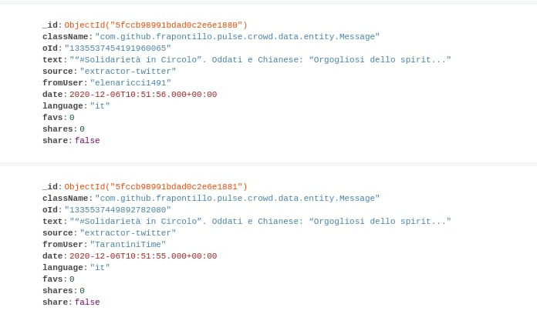
Database
MongoDB is a non-relational, document-oriented DBMS.
The high availability, horizontal scalability and geographical distribution are native, and it is easy to use. In the database, _id, text and locations have been indexed so to speed up information retrieval. Indexes support the efficient execution of queries. Without indexes, MongoDB must perform a collection scan to select those documents that match the query statement. If an appropriate index exists for a query, MongoDB can use the index to limit the number of documents it must inspect.

Slide 10

twitter_requests.py
I chose to develop an application in Python since it fits very well for analysis problem. It is also object-oriented and provides a lot of functions to connect to MongoDB databases. The retrieval of tweets can be done with these parameters:
query: words in the text of the tweet;
sentiment_min: minimum sentiment;
sentiment_max: maximum sentiment;
geo: geographical coordinates of the polygon in which looking for tweets;
time: time from which to collect tweets;

Slide 11

Indexes
Indexed fields can be exploited very well in MongoDB since many filters are available. This is an example in which I use filters on date for comparisons and on locations to verify if the field exists.
if(only_geo == True):
tweets = list(db.Message.find({"$and": [
{"date": {
"$gte": int2time(start),
"$lt": int2time(end)
}},
{"location": {"$exists": True} }
]}))
else:
tweets = list(db.Message.find({"date": {
"$gte": int2time(start),
"$lt": int2time(end)
}} ))

Slide 12


backup
We have also developed a backup function to store a copy (maybe updated) version of the database. In this function we can specify the date (of storing) from which to backup tweets. The destination folder has been provided by professor Cassotti on his personal Google Drive repository. An hash function determines whether the operation succeded.
Copies can be recovered through the function read_backups, developed by us as well.

Slide 13
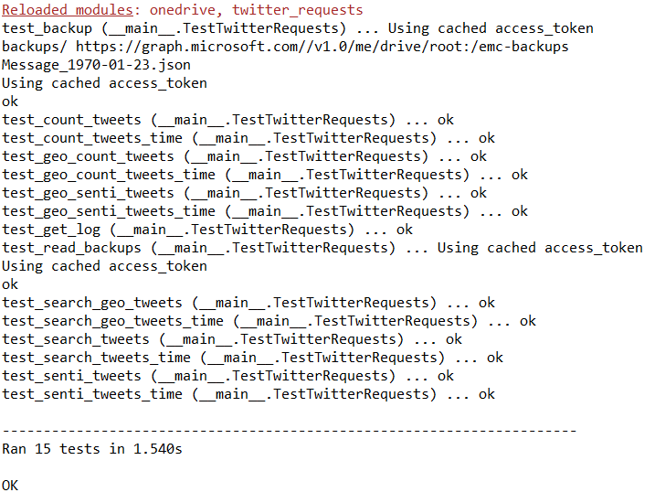

Pyunit
For unit tests, I used the Pyunit framework. It consists in creating a test class which verifies a list of assertions written manually.

Slide 14
Considerations and future expansions
Considerations:
Emotional City is a powerful tool to discover opinions about specific topics during period of times;
If integrated in a platform, it can represent a source of knowledge for citizens. The more public information is available, the more the community feels part of the society;
It can be also useful to understand the behavior of the people in social by monitoring the number of tweets during some period or by specific zones;
If citizens start to use it frequently, it can become a cultural symbol for the Apulia region.
Future expansions:
twitter_requests.py must be integrated in a platform that can be queried by end users;
New tweets must be gathered, even from many years ago if we would like to keep track of opinions during time;
Integrating data coming from other sources;

Slide 15
THANKS
Do you have any questions?
d.dipierro7@studenti.uniba.com

